Slide 1
24MAT120
S2 P&M

Slide 2
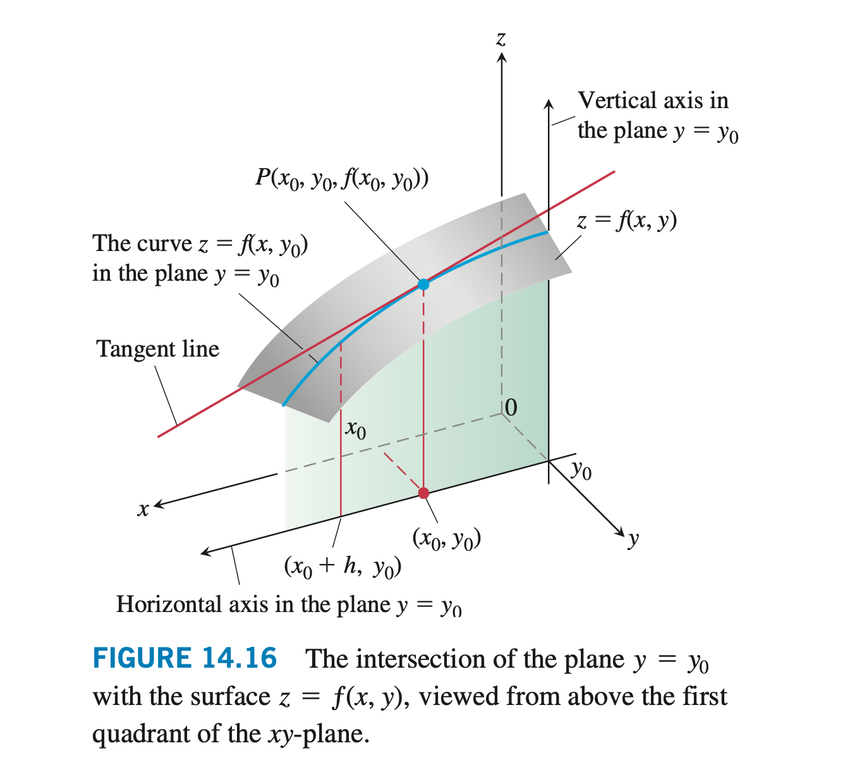

Slide 3



Slide 4
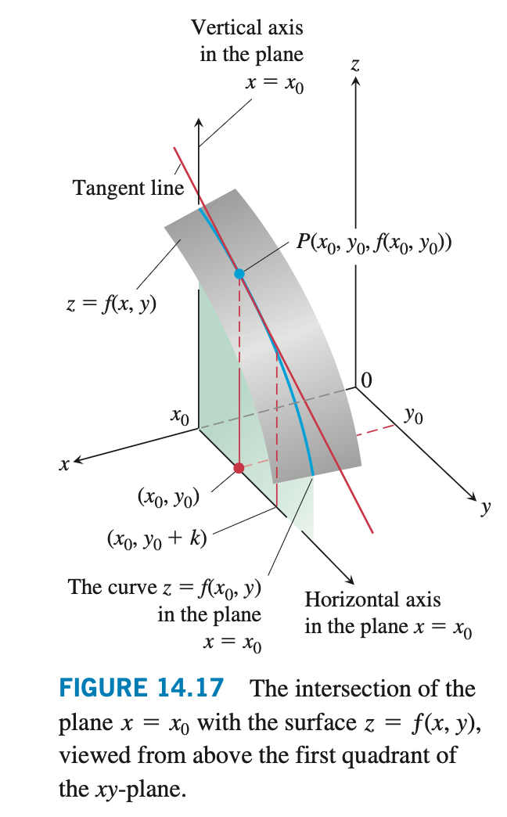

Slide 5


Slide 6


Slide 7
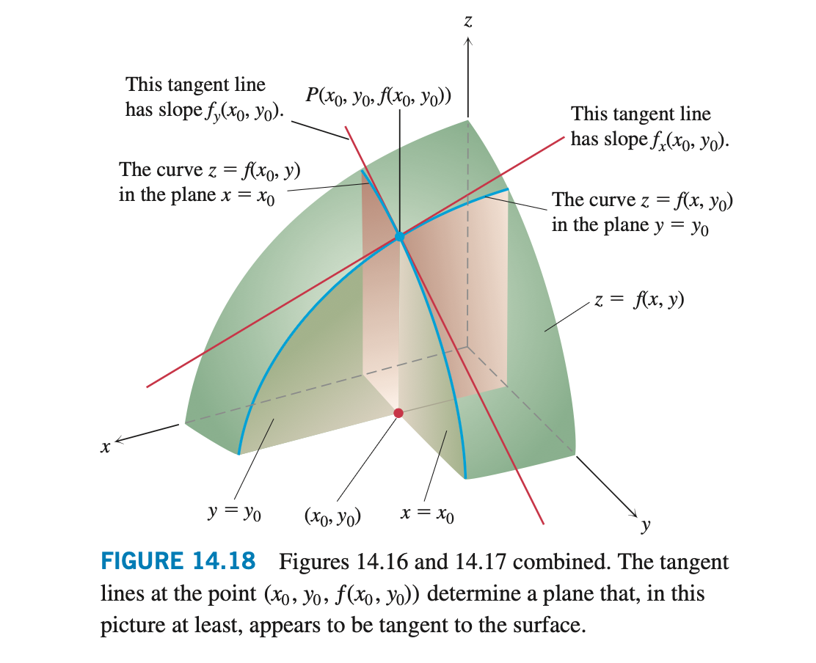

Slide 8
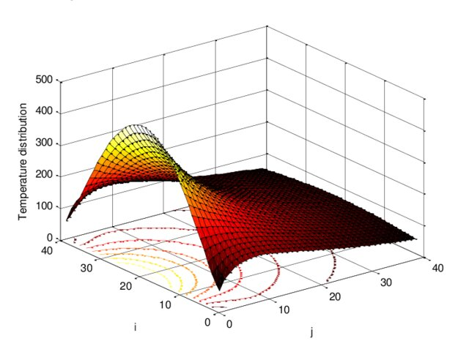

Slide 9
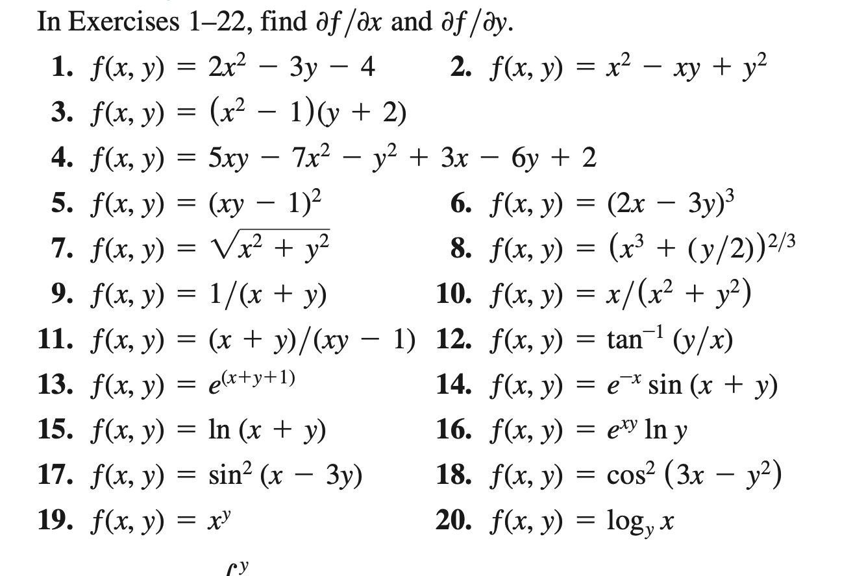
7,9,10,15,20

Slide 10
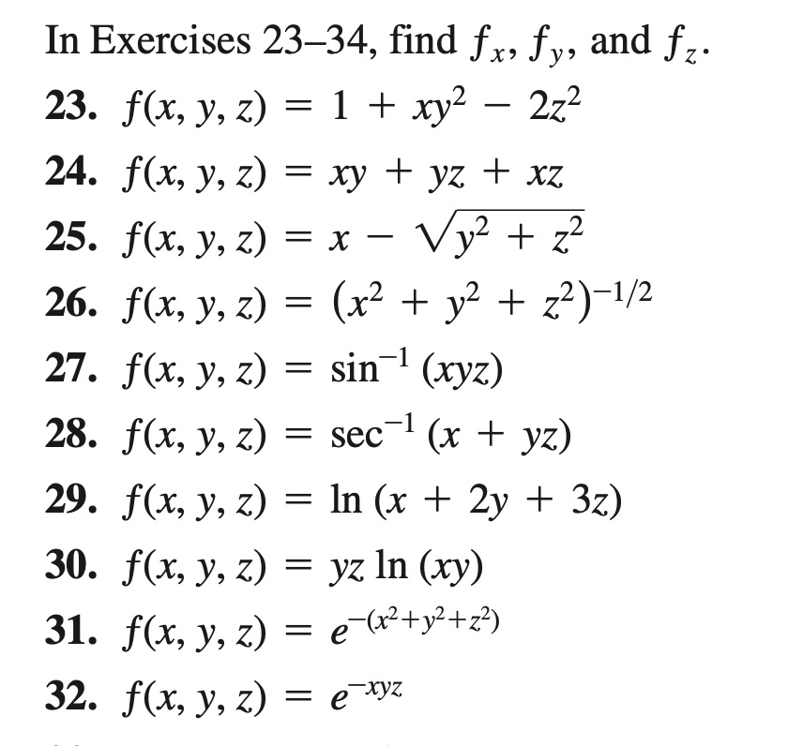
23,26,30,31,32

